Slide 1
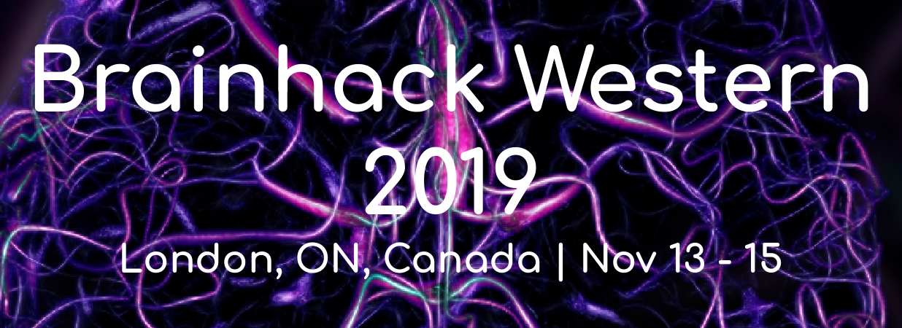
Intro to Deep Learning
Presented by Jordan DeKraker and Haider Al-Tahan
https://github.com/haideraltahan/DeepLearningIntro-BrainHack

Slide 2
Goals
Basic introductions to Neural Networks & training with backpropagation
Common architectures, semi- and sparse-supervision problems
Advanced topics & discussions

Slide 3
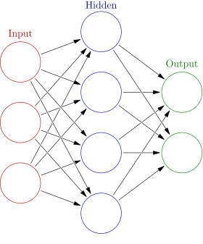
My first NN
Iterative backpropagation
Look at the ‘supervision’ signal, the difference with the actual output is the error
Adjust weights accordingly
This is applied many times in random changing orders, but with a small ‘step size’ or learning rate
1 neuron will converge on linear regression
N neurons can approximate any function
Train, test, and validation datasets are kept separate

Slide 4
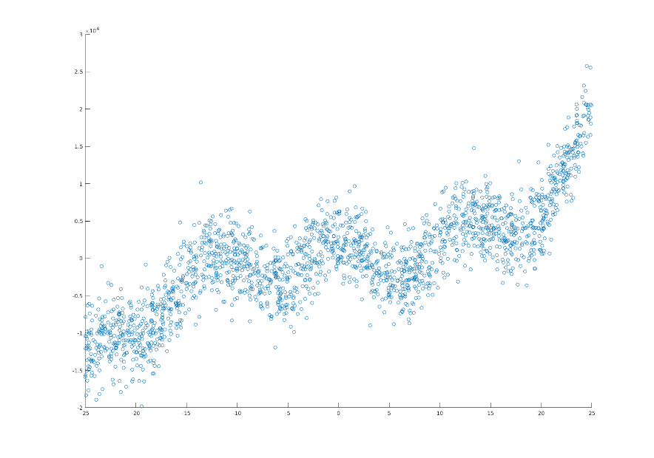
Overfitting and Generalizability
Neurons can act in parallel or converge, and can converge at different depths & in many different combination
Avg of many models

Slide 5
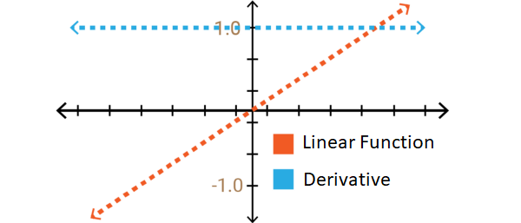
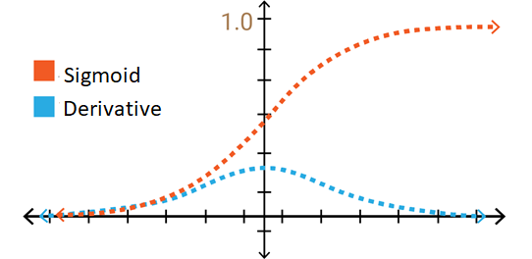
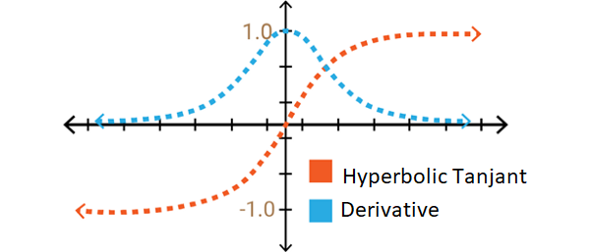
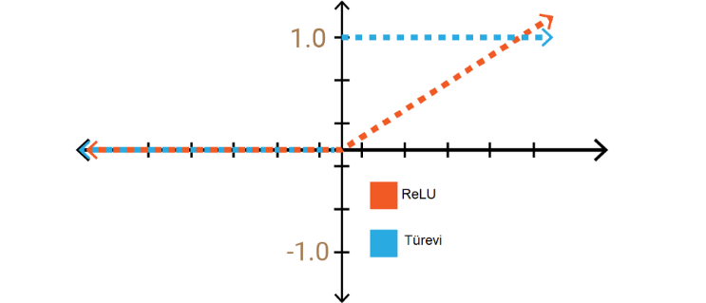
Non-linear activation functions
Activation functions are applied to the sum of a neuron’s inputs
Must be differentiable for error to be backpropagated
‘Bias’ is typically introduced at each neuron to shift activation functions left or right
Biological analogues could be dendritic branching patterns (ie. the thing in between the sum of inputs and the soma of the cell), or protein expression profiles, or even microcircuits at longer timescales.
If you had a good reason, any basis function could be used (e.g. sine&cosine for Fourier transform)
In practice, simplicity is better (eg. fast simple function, same function for all neurons)

Slide 6
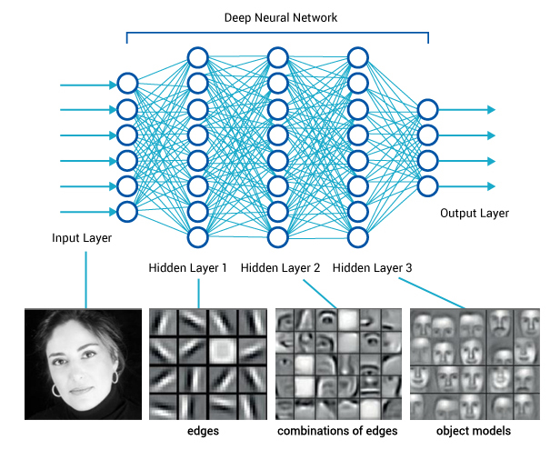
Stacking layers
N neurons in a layer increases its capacity/precision
L layers increases overall abstraction, or what I like to call ‘multiple-realizability’

Slide 7
Stacking layers
NNs will try to ‘cheat’ whenever they can
e.g. look at a few pixels, if they match ‘input A’ then produce ‘output A’ (1:1 mapping)
We need to force the network to learn deeper conjunctions of features by ‘swapping out’ features that are interchangeable
Having many samples means its easier to
detect regularities between higher-level ‘conjunctions’ of features
than it is to
match every low level feature

Slide 8
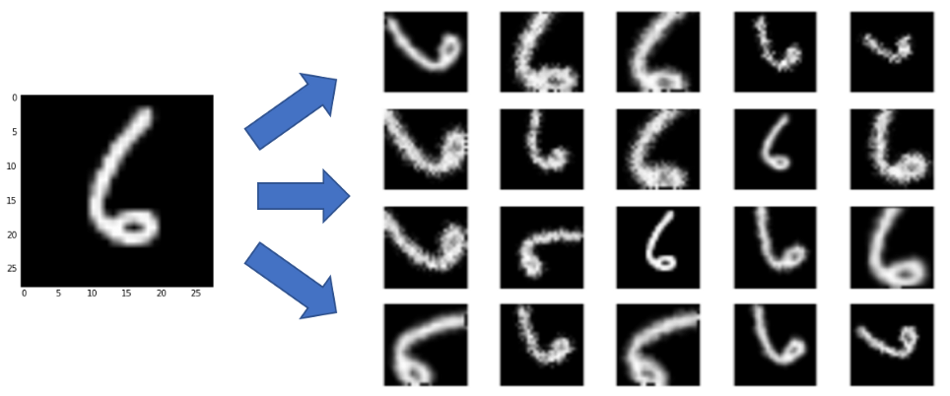
Augmentation and interchangeability
Augmentation changes pixel values without changing their higher-level features
E.g. random shifts, scales, rotations, flips, noise, diffeomorphisms
There is an infinite space of possible augmentations
However, augmentations need to be constrained:
Interchangeable (E.g. 180⁰ rotation 6→9)
Realistic (not helpful if never encountered in test datasets)

Slide 9
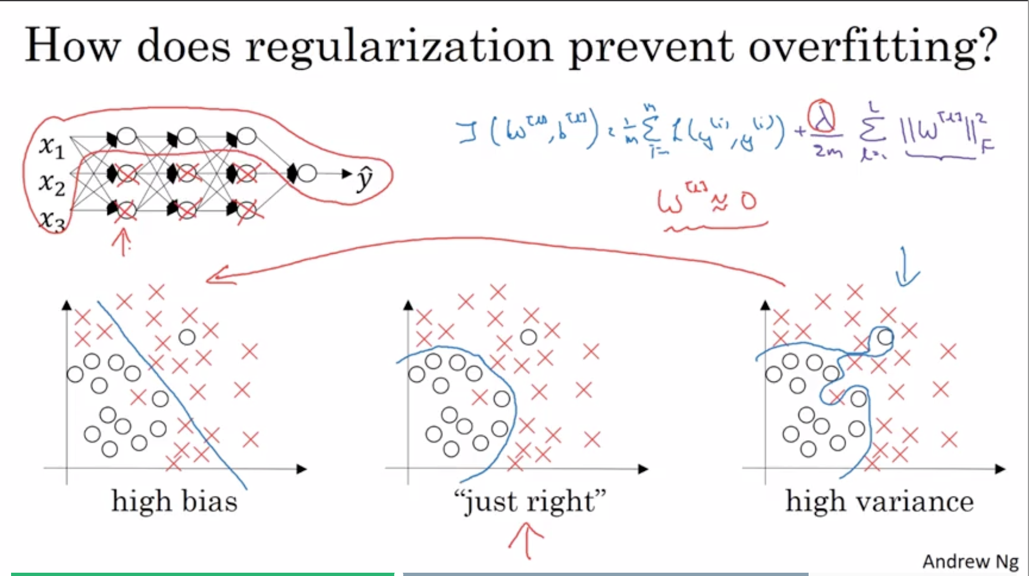
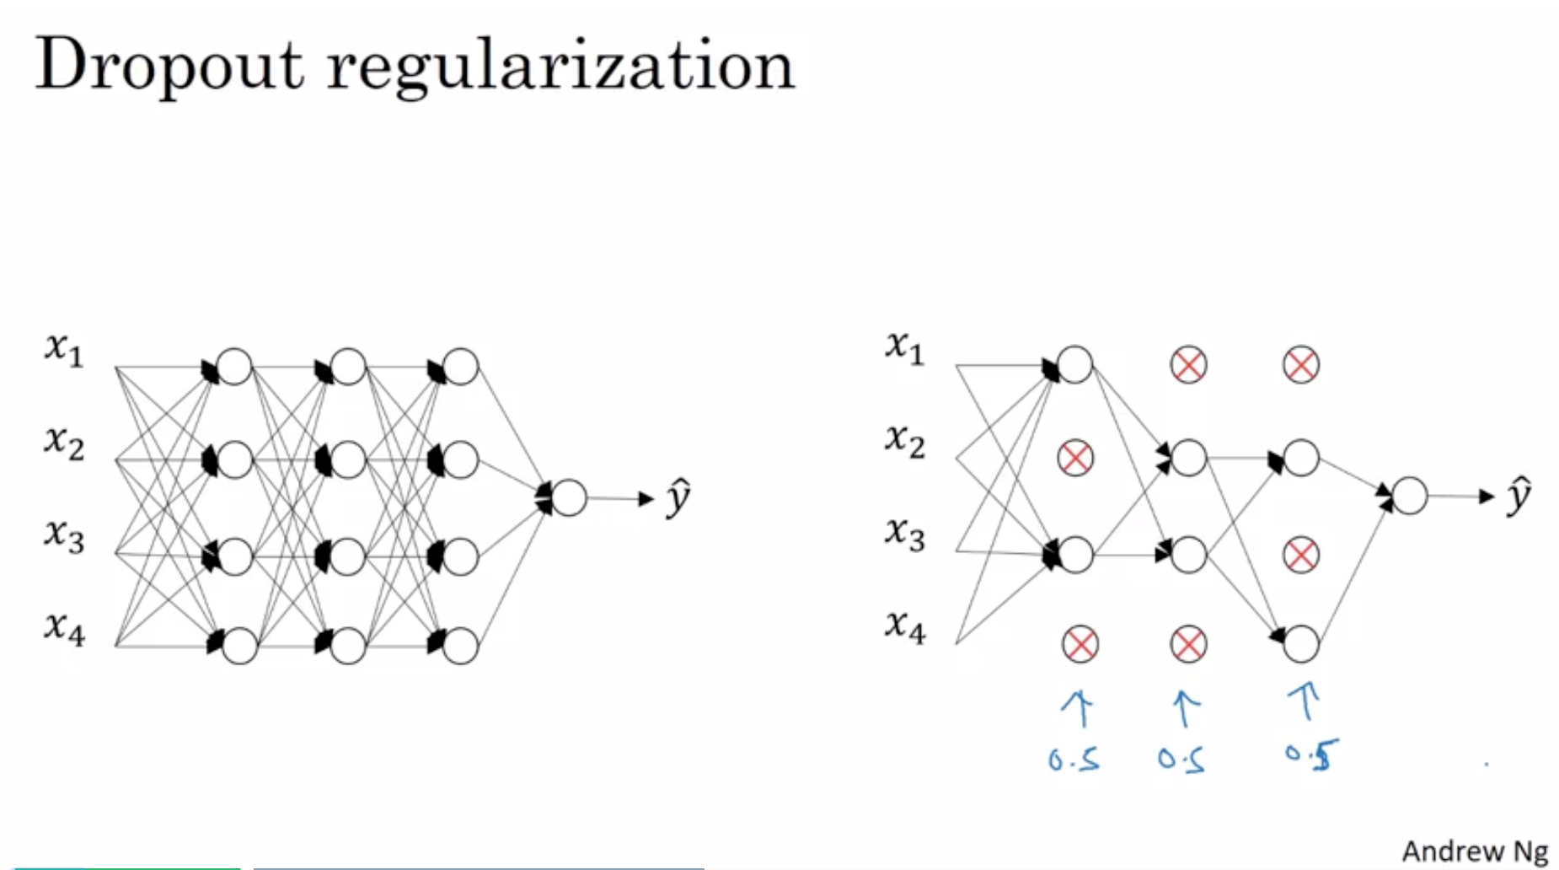
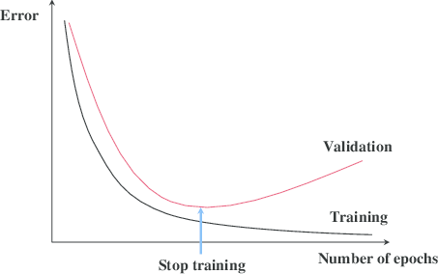
Other ways to improve
Regularization: L1 or L2
Add a ‘cost’ to having weights that are too large
Regularization: drop-out
Effectively training multiple networks in parallel then averaging them. Can’t rely on any one feature, so have to spread out weights
Stopping early:
Even when we do all of the above, eventually the network will find idiosyncratic ‘shortcuts’, especially in small training datasets

Slide 10
Part 1: rest & digest
A basic NN can map inputs to outputs, but we need to give it some guidelines. Most ML libraries will do all this automatically, but sometimes they need troubleshooting
Broader concepts:
precision/capacity
abstraction/multiple-realizability/interchangeability
You need to trick your NN into learning deeply. Don’t let it trick you!

Slide 11
Goals
Basic introductions to Neural Networks & training with backpropagation
Common architectures, semi- and sparse-supervision problems
Advanced topics & discussions

Slide 12
Convolutional NNs
Features (e.g. Gabors) do not need to be re-learned for every image location
Reusing the same set of features can reduce the number of neurons required
Increased capacity for equivalently sized NN
Decreased training time/samples required for a smaller NN

Slide 13
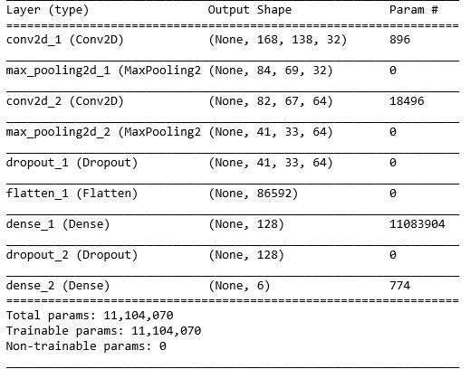
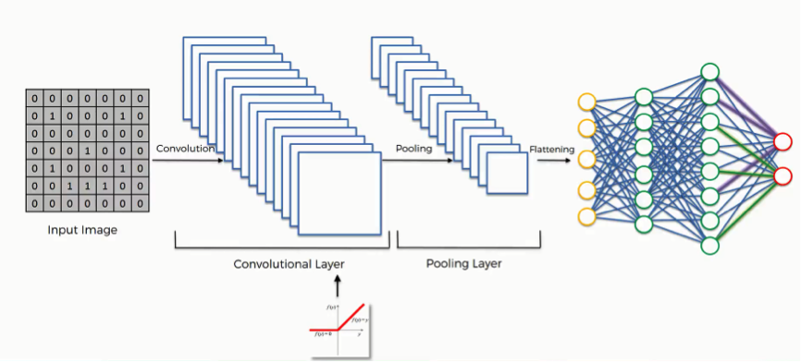
Convolutional NNs
Instead, a set of C convolutional ‘filters’ can be applied at all locations
‘maxPooling’ often used in conjunction
170
140

Slide 14
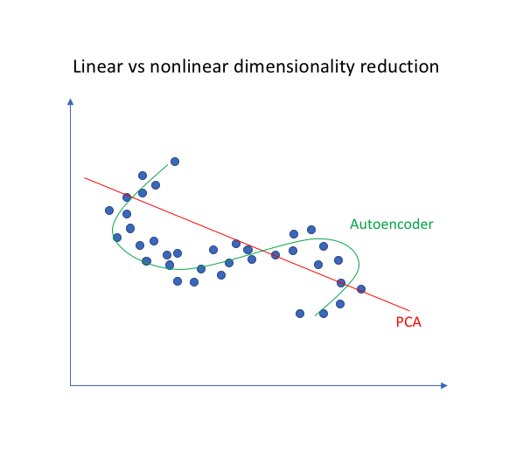
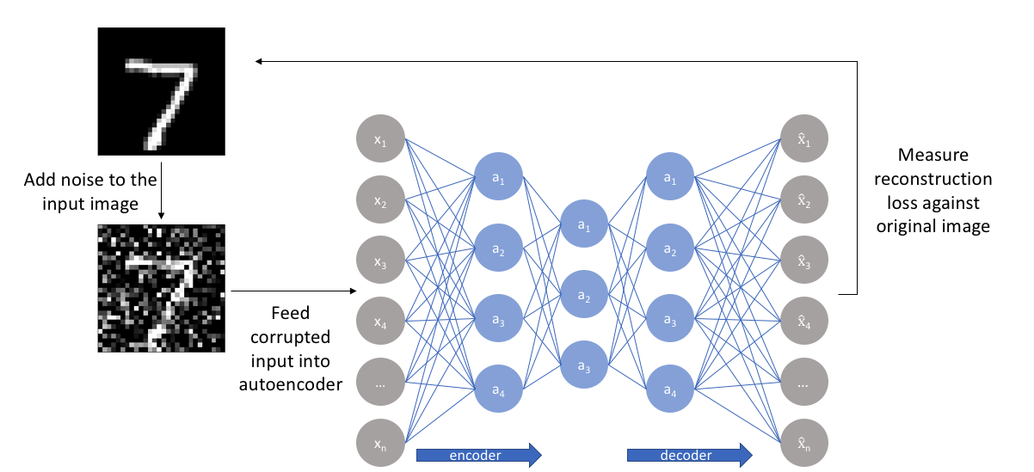
AutoEncoders
Sidebar: with N neurons at the bottleneck and linear activation functions, AE = PCA with N components
Compression assumes inputs are not independent
Applications:
Anomaly detection
Denoising
Inpainting
Quantifying uniqueness, depth & capacity
Compression & compressed sensing

Slide 15
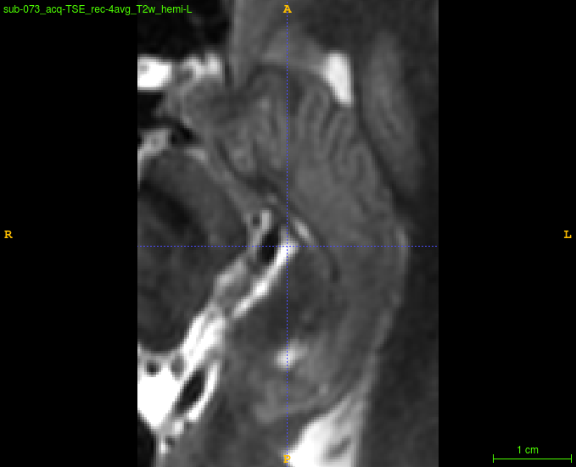
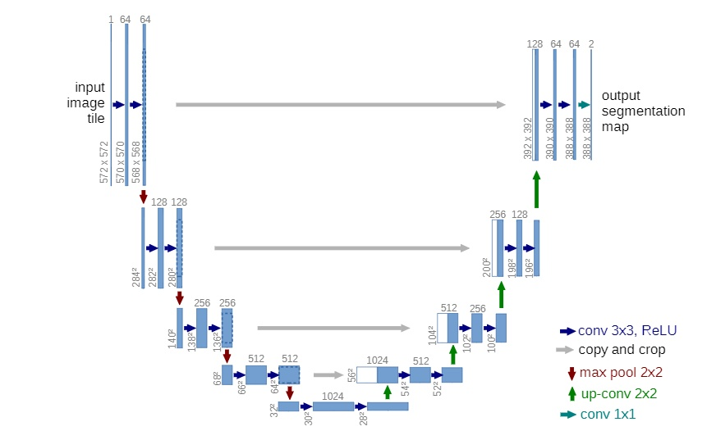
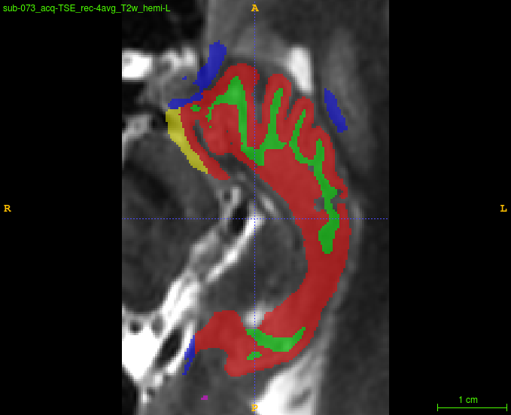
CNN encoding + decoding: U-net and V-net
encoder
decoder

Slide 16
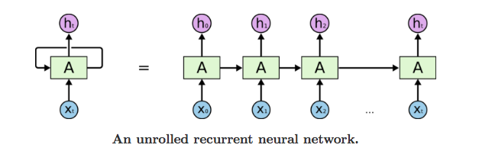
Recurrent NNs
RNNs reduce the number of required parameters, similarly to CNNs
Data is not input all at once but rather in sequence, with some representations being maintained over time
Data being passed (concatenated) from one step to the next is typically called the hidden ‘state’

Slide 17
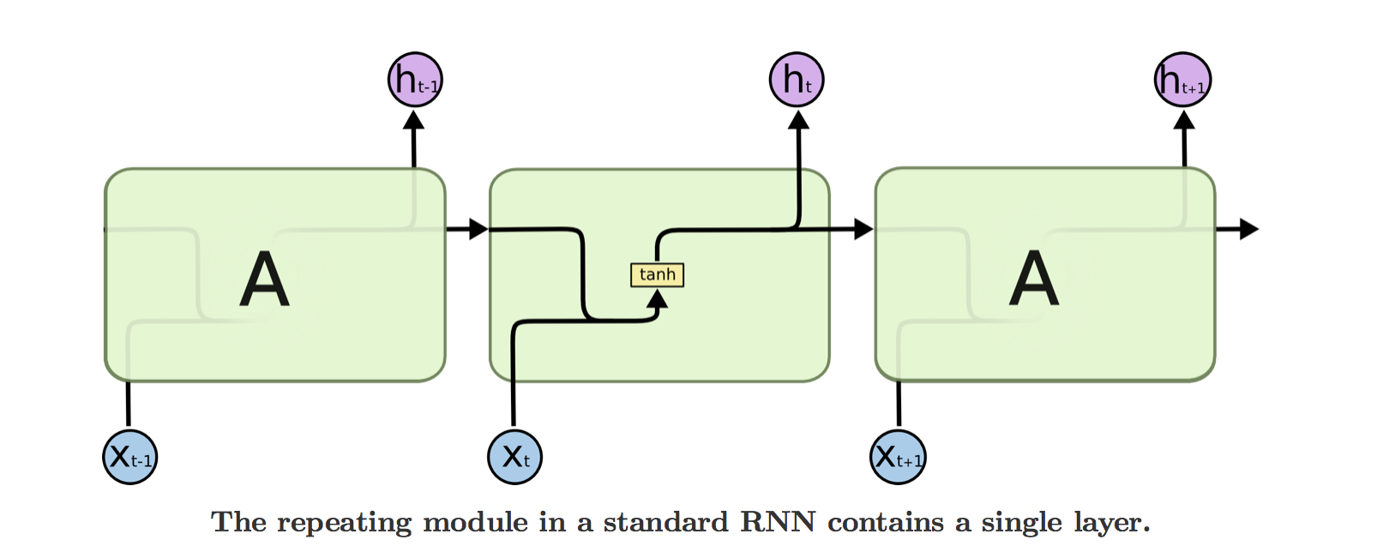
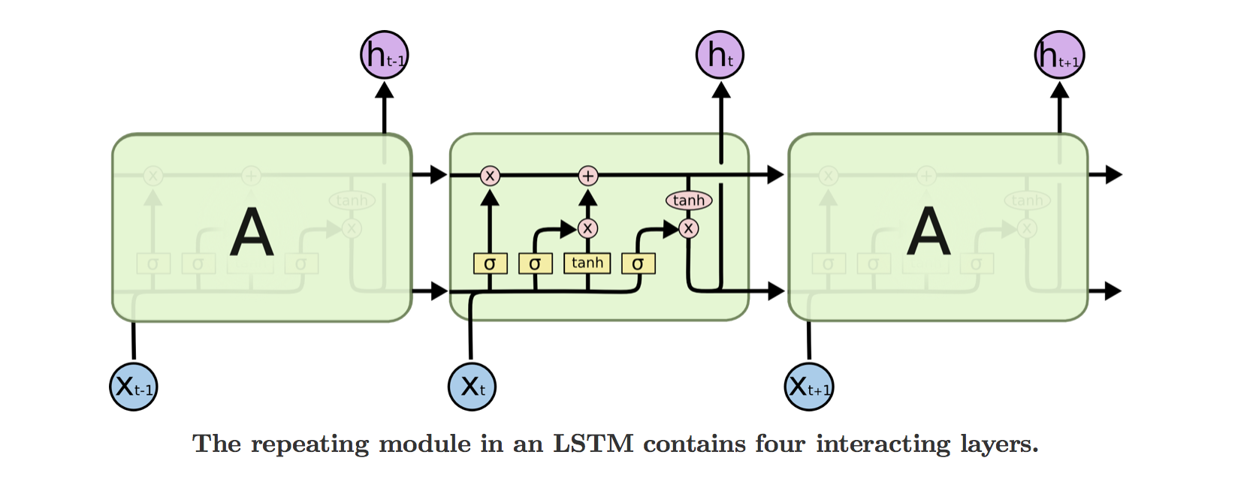
Long-term Short-term Memory Networks
Problem: vanishing gradients & information decay with long-term dependencies
Solution: ‘gatekeeping’ parameters for the hidden state
Input gate: which vector elements should be added to the state & kept isolated
Forget gate: step-by-step decay of state vector elements
Output gate: which vector elements should be concatenated to next input

Slide 18
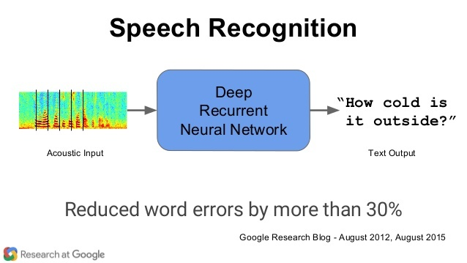
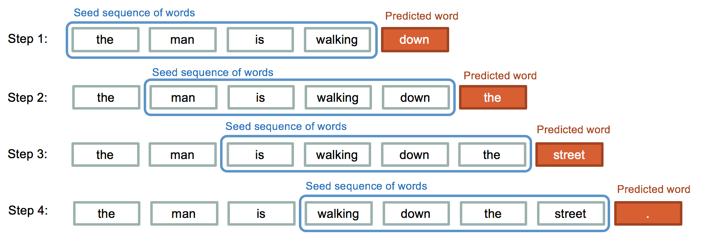
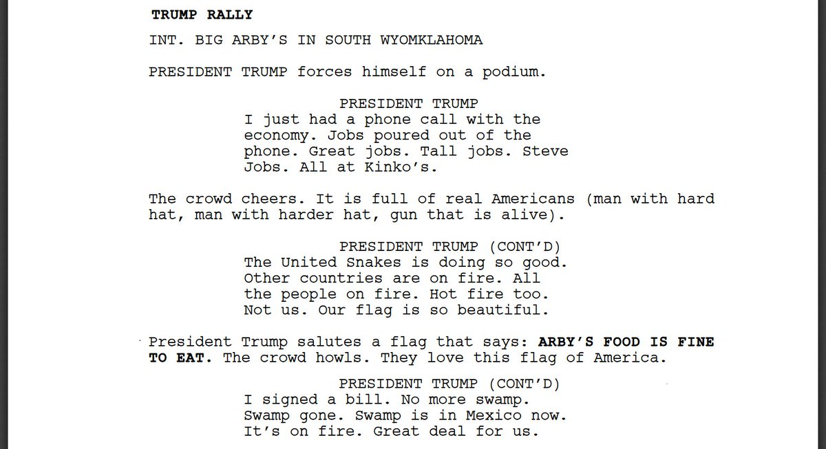
Long-term Short-term Memory Networks

Slide 19
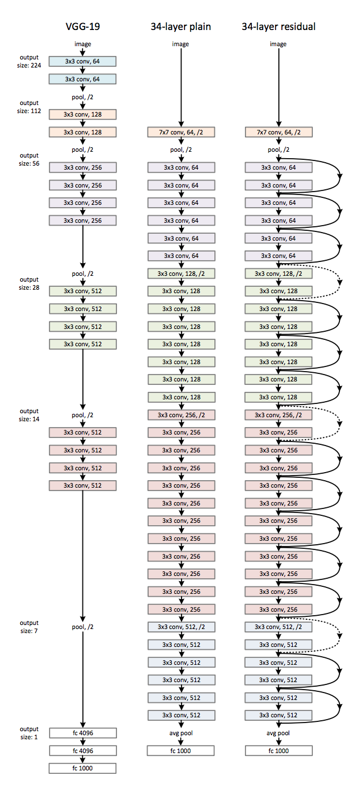
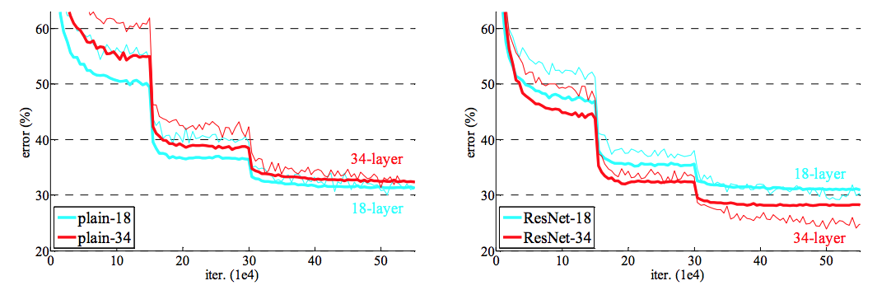
Residual NNs: when you’re in too deep
Very deep NNs are good, but show decay (vanishing error gradients just like in RNNs)
Residual connections introduce additional ‘shortcut’ connections to keep gradients alive

Slide 20
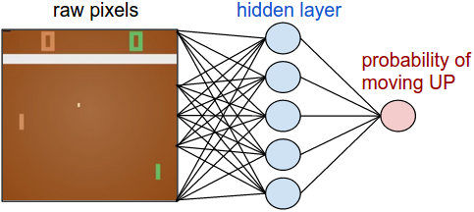
Sparse and semi-supervised strategies
So far, all of these networks are fully supervised – for each input there is a corresponding correct output (except the AE where the correct output is the same as the input)
Deep reinforcement learning can use all the same tools, where the output is a set of possible actions
Typically, the action linked to the max activity output neuron is performed
The ‘correct’ learning signal is all zeros, with the max neuron set to its own activity * a reinforcement signal (positive or negative)
This is a very ‘sparse’ supervision signal, requires MANY iterations

Slide 21
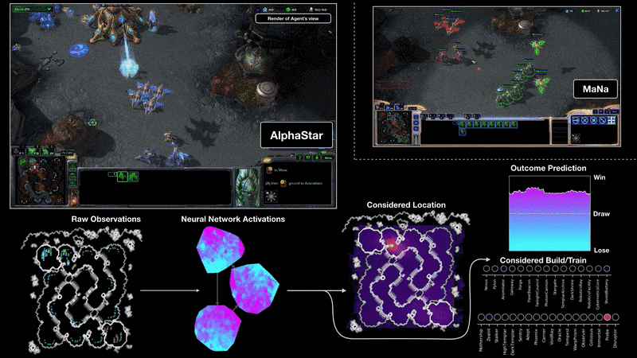
Sparse and semi-supervised strategies
Instead of pure RL, a NN can be trained to try and predict what a human would do
After that has been learned, the training signal can be changed back to pure RL, allowing the NN to ‘experiment’

Slide 22
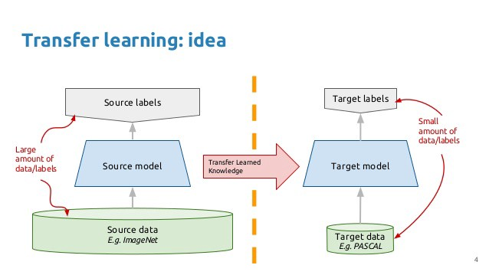
Transfer learning / pretraining
By exactly the same token, a NN trained on one dataset can then undergo training on a second dataset with some reasonable NN connections already in place
Very helpful for small datasets

Slide 23

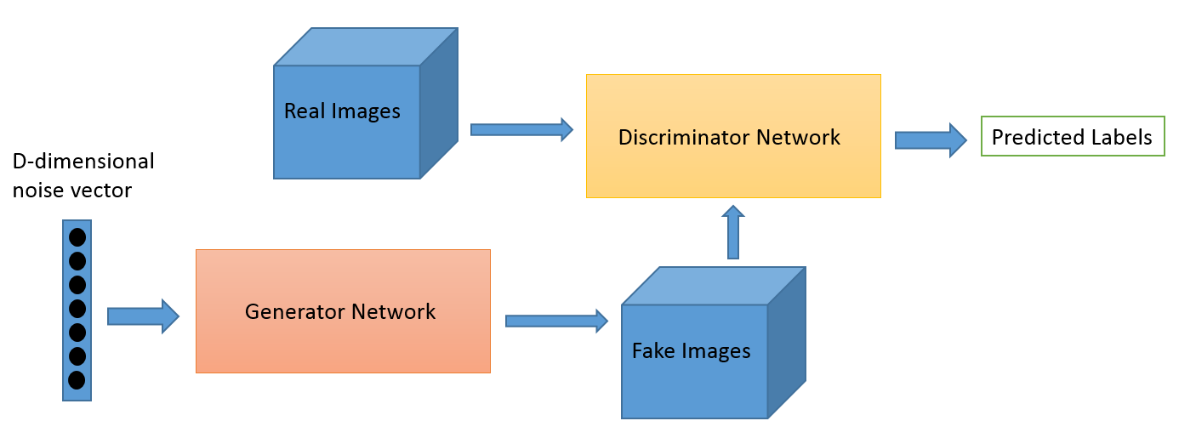
Generative Adversarial Networks
Generative and Discriminator networks learn in concert
Generative models can make cool stuff

Slide 24
Part 2: rest & digest
Broader concepts:
Systematically reduce/reuse parameters
CNNs reuse features across locations
RNNs reuse information forward in time
Deeper is better, until gradients vanish
Gate parameters on RNNs
Residual connections reduce gradient loss
Try to get supervision wherever possible
AEs can learn a lot from data with no supervision
Deep RL is usually sparse supervision. Semi-supervision helps!
GANs can learn a lot from data with no supervision

Slide 25
Goals
Basic introductions to Neural Networks & training with backpropagation
Common architectures, semi- and sparse-supervision problems
Advanced topics & discussions
Outstanding problems
Biological plausibility
Ethics in AI

Slide 26
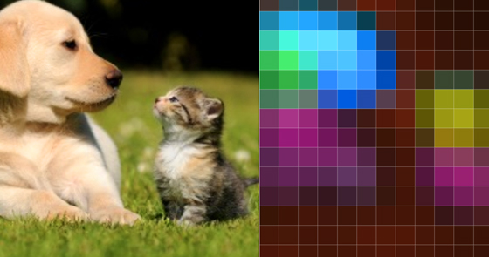
Are NNs blackboxes?
This is a critical question for research and policy makers
https://distill.pub/2018/building-blocks/

Slide 27
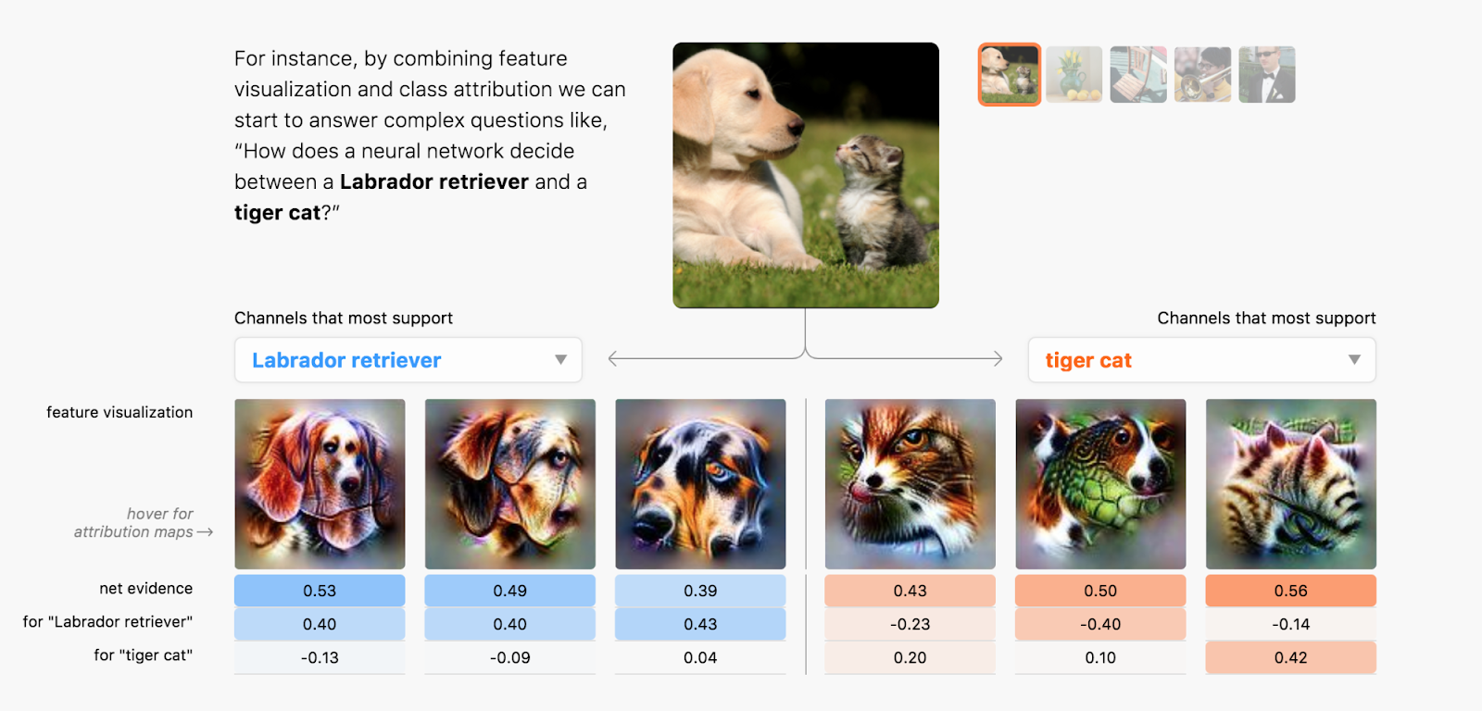
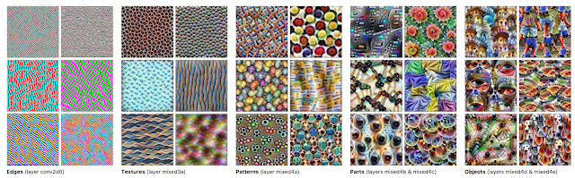
Are NNs blackboxes?
https://distill.pub/2018/building-blocks/

Slide 28
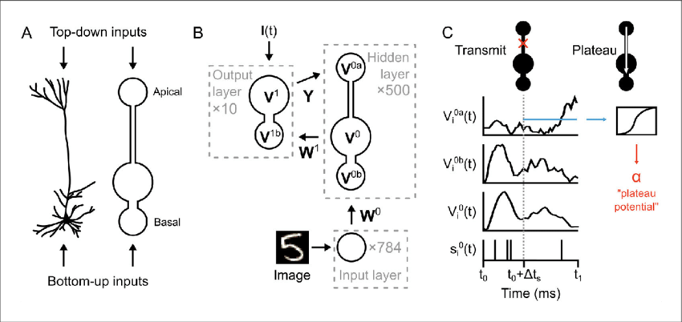
Are NNs like neurons?
NN neurons maintain a value for their activity and again for their error signal
Many other proposals exist to answer this question, at different spatial and temporal scales (eg. multiplexing)

Slide 29
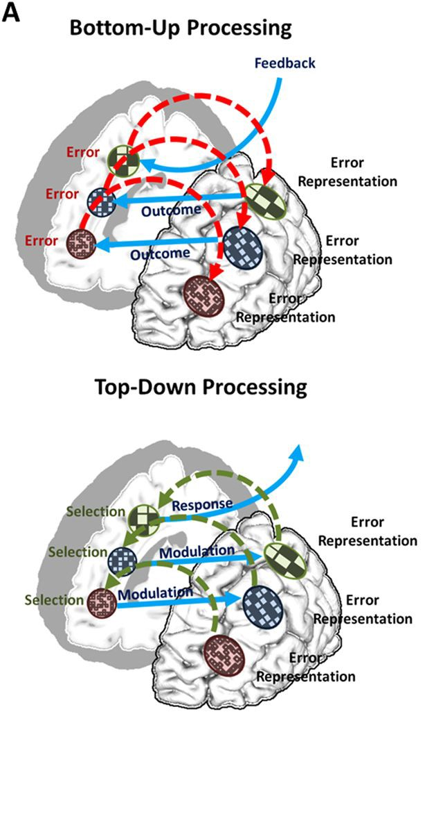
What are our learning signals?
Evolutionary pre-training
Innate or perceived reinforcement (sparse)
Predictive coding

Slide 30
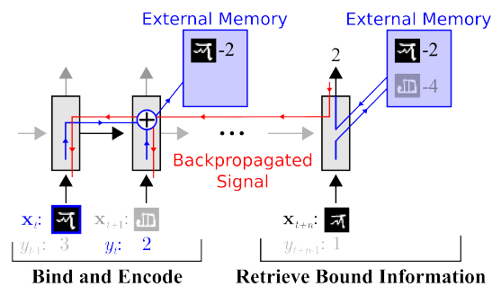
1-shot and 0-shot learning
Humans and animals don’t need millions of learning trials
Typical computerized memory is 1-shot, NNs are not
Neural Turing Machine: hard-coded memory slots with an operator choosing when&where to read&write
Memory-augmented NN

Slide 31
Other outstanding challenges
Viewpoint-invariant representation
Video-prediction, object tracking
Small, noisy, or incomplete data
What makes a problem well-posed?
Interpretability of NN models
There are no experts. You are the expert now.

Slide 32
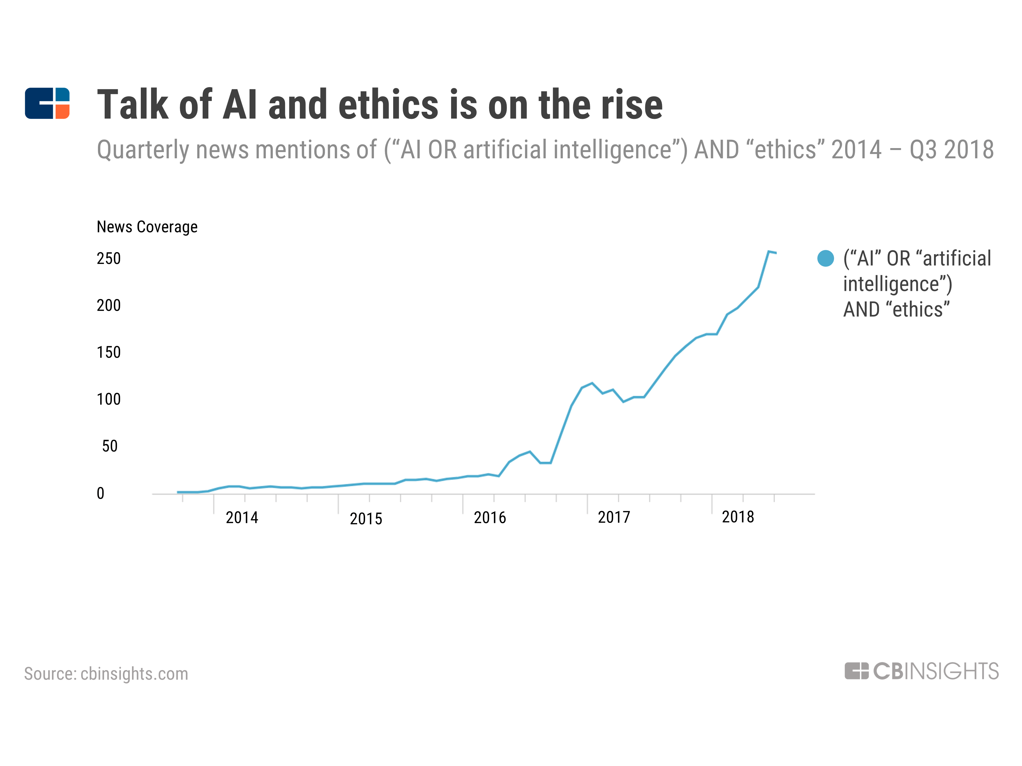
Ethics in AI
Impacts on society
Existential threat?
Wealth inequality
Accountability, policy and education
Openness of information
Obligation to minimize suffering
Can an AI be conscious
Replacement, Reduction, Refinement
Could we tolerate not being the smartest beings?

Slide 33
Resources
https://blog.usejournal.com/
https://www.jeremyjordan.me/
https://www.analyticsvidhya.com/blog/
https://medium.com/
https://www.coursera.org/instructor/andrewng

